Slide 1
Subject: Programming in Python
Part-4
CSE3&IT
Neha Chadha
IT Department

Slide 2

Formatting
Format Symbol | Conversion
%c | character
%s | string conversion via str() prior to formatting
%i | signed decimal integer
%d | signed decimal integer
%u | unsigned decimal integer
%o | octal integer
%x | hexadecimal integer (lowercase letters)
%X | hexadecimal integer (UPPERcase letters)
%e | exponential notation (with lowercase 'e')
%E | exponential notation (with UPPERcase 'E')
%f | floating point real number
%g | the shorter of %f and %e
%G | the shorter of %f and %E

Slide 3
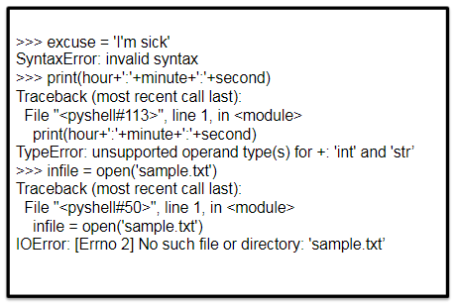
Errors & Formatting

Slide 4
Types of errors
Syntax Errors
Exceptions

Slide 5
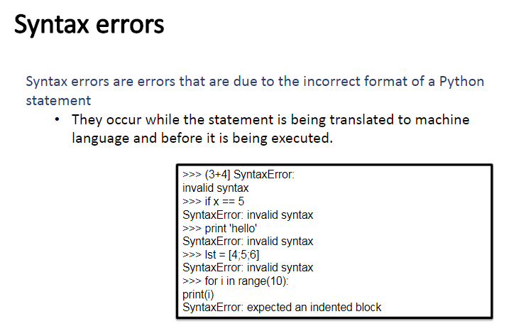

Slide 6
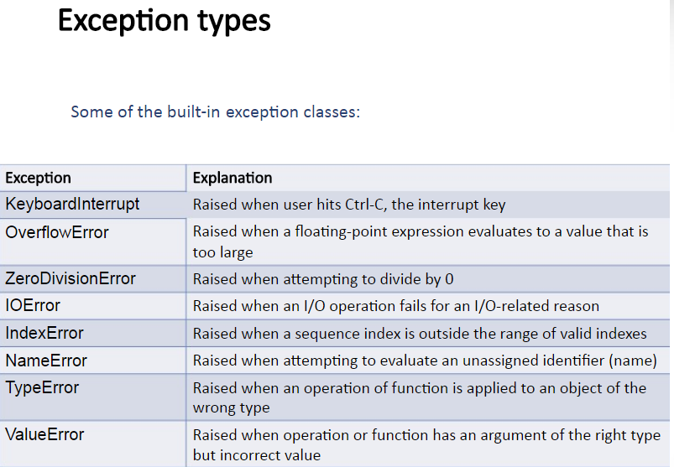

Slide 7
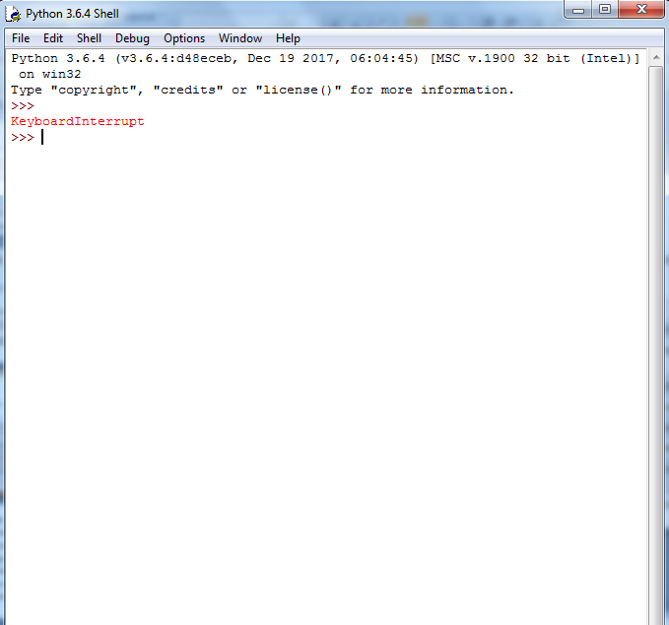

Slide 8
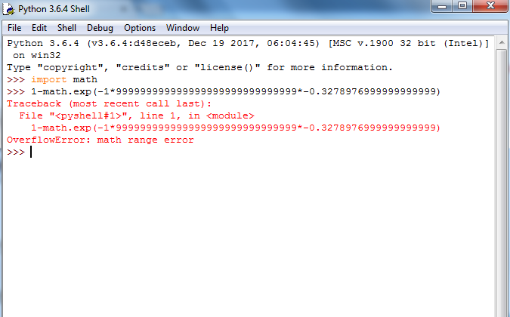

Slide 9
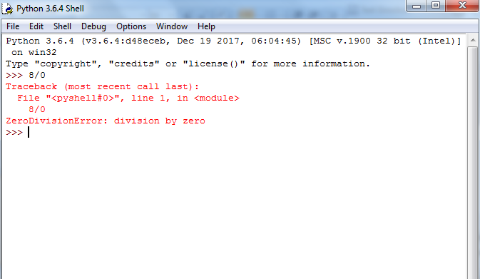

Slide 10
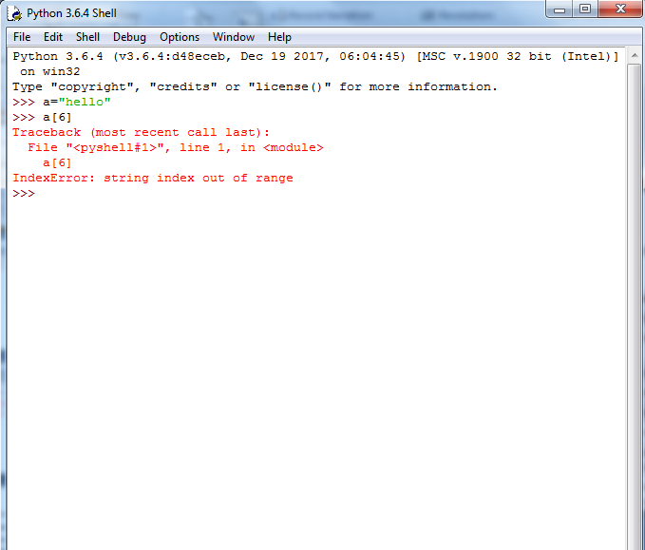

Slide 11
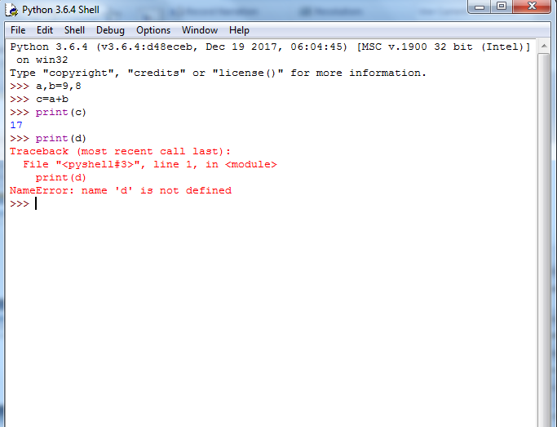

Slide 12
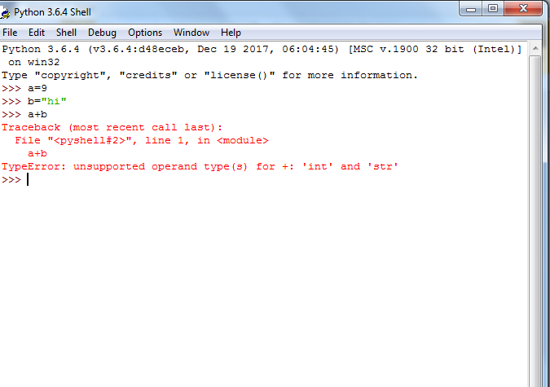

Slide 13
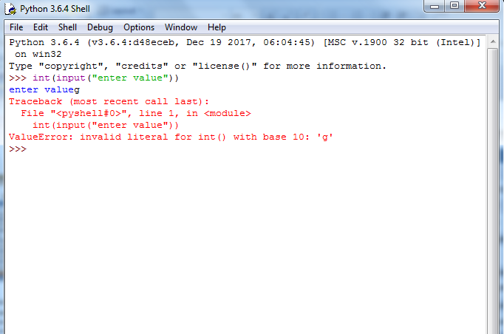

Slide 14
Exception Handling
Python provides two very important features to handle any unexpected error in your Python programs and to add debugging capabilities in them
Exception Handling
Assertions

Slide 15
Exception
An exception is an error that happens during execution of a program. When that error occurs, Python generate an exception that can be handled, which avoids your program to crash.

Slide 16
Why use Exceptions?
Exceptions are convenient in many ways for handling errors and special conditions in a program.
When you think that you have a code which can produce an error then you can use exception handling.

Slide 17
Exception Handling(try,except)
Exception handling enables you handle errors gracefully and do something meaningful about it. Like display a message to user if intended file not found. Python handles exception using try.. except .. block.

Slide 18
Syntax of try ,except
try:
# write some code
# that might throw exception
except <ExceptionType>:
# Exception handler, alert the user
1. First statement between try and except block are executed.
2. If no exception occurs then code under except clause will be skipped.
3. When exceptions occurs, if the exception type matches exception name after except keyword, then the code in that except clause is executed.

Slide 19
try, except
try:
num1 =int(input("Enter 1 number "))
num2 = int(input("Enter 2 numbers "))
result = num1 / num2
print("Result is", result)
except ZeroDivisionError:
print("Division by zero is error !!")

Slide 20
try,except,else,finally
A try statement can have more than once except clause, It can also have optional else and/or finally statement.

Slide 21
Syntax of try,except,else and finally
try:
<body>
except <ExceptionType1>:
<handler1>
except <ExceptionTypeN>:
<handlerN>
except:
<handlerExcept>
else:
<process_else>
finally:
<process_finally>

Slide 22
Explanation of syntax
except clause is similar to elif . When exception occurs, it is checked to match the exception type in except clause. If match is found then handler for the matching case is executed. Also note that in last except clause ExceptionType is omitted. If exception does not match any exception type before the last except clause, then the handler for last except clause is executed.
Note: Statements under the else clause run only when no exception is raised.
Note: Statements in finally block will run every time no matter exception occurs or not.

Slide 23
try,more except,else and finally
try:
num1 = int(input("Enter 1 numbers, separated by a comma : "))
num2 = int(input("Enter 2 numbers, separated by a comma : "))
result = num1 / num2
print("Result is", result)
except ZeroDivisionError:
print("Division by zero is error !!")
except ValueError:
print(“Enter integer number pls")
except:
print("Wrong input")
else:
print("No exceptions")
finally:
print("ok")

Slide 24
Output
The entry is “a”
Oops! error occured.
The entry is 0
Oops! error occured.
The entry is 2
The reciprocal of 2 is 0.5

Slide 25
try:
entry1=int(input("enter value1"))
entry2=int(input("enter value2"))
r = entry1/(entry2)
except ValueError:
print("Oops!error occured")
except ZeroDivisionError:
print("Oops! error occured.”)
else:
print("The reciprocal of",entry,"is",r)

Slide 26
Exception objects
try:
# this code is expected to throw exception
except ExceptionType as ex:
# code to handle exception
try:
entry1=int(input("enter value1"))
entry2=int(input("enter value2"))
r = entry1/(entry2)
except ZeroDivisionError as zde:
print("Oops! error occured.",zde)
else:
print("The reciprocal of",entry,"is",r)

Slide 27
Raising an Exception
You can raise an exception in your own program by using the raise exception statement.
Syntax
raise ExceptionClass("Your argument")

Slide 28
Example of raise exception
age=int(input("enter age"))
if age < 0:
raise ValueError (“Wrong age entered")
print("ok")

Slide 29
Raise example
try:
age=int(input("enter age"))
if age < 0:
raise ValueError()
except:
print("-ve value entered")
else:
print(age)

Slide 30
def enterage(age):
if age < 0:
raise ValueError()
if age % 2 == 0:
print("age is even")
else:
print("age is odd")
try:
num = int(input("Enter your age: "))
enter age(num)
except ValueError:
print("Only positive integers are allowed")
except:
print("something is wrong")

Slide 31
Output
The entry is hi
Error occured
The entry is 0
Error occured
The entry is 2
The reciprocal of 2 is 0.5

Slide 32
Exception as control flow
List = ['hi', 0, 2]
for entry in List:
try:
print("The entry is", entry)
r = 1/int(entry)
except:
print("Error occured\n")
print("The reciprocal of",entry,"is",r)

Slide 33
Programs may name their own exceptions by creating a new exception class.
create a base class for exceptions defined by that module, and subclass that to create specific exception classes for different error conditions.

Slide 34
Assertion
def enterage(age):
assert age>0,"age cant b negative"
print(age)
enterage(-1)

Slide 35
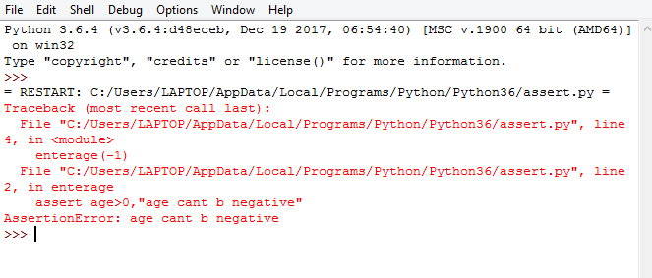
Assertion Error

Slide 36
File
File is a collection of records.
A record is a group of related data items.
These data items contains various information related to student, employees etc.
A file is a collection of numbers , symbols and text and can be considered a stream of characters.

Slide 37
Need of File handling
To store the data permanently created in a program , user needs to save it in a File on a disk or some other devices . The data stored in a file is used to retrieve the user’s information either in part or whole.
Various operations carried out on a file are
Creating a file
Opening a file
Reading a file
Writing a file
Closing a file

Slide 38
Types of Files
Files are divided into two categories
Text Files
Binary Files
Text Files are simple texts in human readable format
Binary files have binary data which understood by the computer.

Slide 39
Text Input and Output
To read data from a file or to write data to a file, a user needs to use the open function to first create a fie object.

Slide 40
Opening a File
A file needs to open before we can perform read and write operations on it.
To open a file, a user needs to first create a file object which is associated with a physical file.
While opening a file, a user has to specify the name of the file and its mode of operation.
Syntax fileobject=open(FileName,Access Mode)
Eg myfile=open(“neha.txt”, “w”)

Slide 41
Syntax fileobject=open(FileName,Access Mode)
Eg myfile=open(“neha.txt”, “w”)
Filename contains a string type value containing the name of file that we want to access
Access Mode specifies that in which mode we want to open that file(read,write,append etc.). The default acess mode is read only.

Slide 42
Different modes to open a File
Mode | Description
r | Opens a file in reading mode. The file pointer is placed at the starting of the file
rb | Opens a file in reading mode in binary format. The file pointer is placed at the starting of the file
r+ | Opens a file in reading and writing mode. The file pointer is placed at the starting of the file
rb+ | Opens a in reading and writing mode in binary format. The file pointer is placed at the starting of the file
w | Opens a file in writing mode. Overwrite existing file, otherwise it creates new file
wb | Opens a file in writing mode in binary format. Overwrite existing file, otherwise it creates new file
w+ | Opens a file in reading and writing mode. Overwrite existing file, otherwise it creates new file
wb+ | Opens a file in reading and writing mode in binary format. Overwrite existing file, otherwise it creates new file

Slide 43
Mode | Description
a | Opens a file for appending. The file pointer is placed at the starting of the file Creates new file if not existing for writing.
ab | Opens a file for appending in binary format. The file pointer is placed at the starting of the file Creates new file if not existing for writing.
a+ | Opens a file for appending and reading. The file pointer is placed at the starting of the file Creates new file if not existing for writing.
ab+ | Opens a file for appending and reading in binary format. The file pointer is placed at the starting of the file Creates new file if not existing for writing.

Slide 44
Closing a File
When the operations that are performed on an opened file are finished , we have to close the file.
The closing of file is done with built in function close()
Syntax fileobject.close()
Eg myfile.close()

Slide 45
Programs Syntax
1. fileobject=open(FileName,Access Mode)
Perform file operations
fileobject.close()
2. with open(FileName) as fileobject:
print (fileobject.accessmode())
fileobject.close()

Slide 46
w mode
myfile=open("neha.txt","w")
myfile.write("hi hw r u")
myfile.close()
print("successfully written")

Slide 47
r mode
myfile1=open("neha.txt","r")
print(myfile1.read())
myfile1.close()

Slide 48
r mode with byte size
myfile1=open("neha.txt","r")
print(myfile1.read(2))
myfile1.close()

Slide 49
readline
myfile=open("neha.txt","w")
myfile.write("hi hw r u1\n")
myfile.write("hi hw r u2\n")
myfile.close()
print("successfully written")
myfile=open("neha.txt","r")
print(myfile.readline()) # read 1st line
print(myfile.readline()) # read 2nd line
print(myfile.readline()) # no output
myfile.close()

Slide 50
readlines (return output as list)
myfile=open("neha.txt","r")
print(myfile.readlines())
myfile.close()

Slide 51
a mode
myfile=open("neha.txt","a")
myfile.write("hi hw r u567")
myfile.close()

Slide 52
w,r,a mode usage
myfile=open("neha.txt","w")
myfile.write("hi hw r u")
myfile.close()
myfile=open("neha.txt","w")
myfile.write("hi hw r u123")
myfile.close()
myfile=open("neha.txt","a")
myfile.write("hi hw r u567")
myfile.close()
print("successfully written")
myfile1=open("neha.txt","r")
print(myfile1.read())
myfile1.close()

Slide 53
Program to write sentence using function
def main():
myfile=open("neha1.txt","w")
myfile.write("hi hw r u")
main()

Slide 54
WAP to count no. of vowels in a text file
filename=input("enter file name")
obj=open(filename)
x=obj.read()
c=0
for char in x:
if char =='A'or char=='a….':
c=c+1
print(c)

Slide 55
WAP to print first letter of each line in capital.
filename=input("enter file name")
obj=open(filename)
for char in obj:
l=char.capitalize()
print(l)

Slide 56
WAP to Append and Read Number in text file
myfile=open("n.txt","w")
for x in range(1,20):
(myfile.write(str(x)))
myfile.close()
myfile=open("n.txt","a")
for x in range(20,41):
(myfile.write(str(x)))
myfile.close()
myfile=open("n.txt")
print(myfile.read( ))
myfile.close()

Slide 57
CSV file
Comma separated values file is a readable text file where each line has different fields separated by a comma.

Slide 58
Read a CSV File in Python
Python has inbuilt module i.e CSV, which is used for working with CSV files. In python, we use csv.reader module to read a CSV file.

Slide 59
Read from csv file
import csv
csvfile= open("1.csv")
readCSV=csv.reader(csvfile)
for row in readCSV:
print(row)

Slide 60
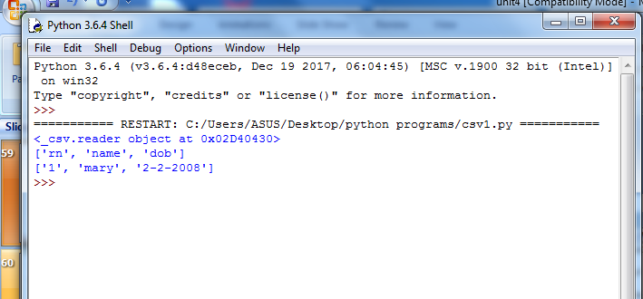

Slide 61
Write in a CSV File in Python
import csv
csvData = [['Name of Person', 'Age'], ['Peter', '22'], ['Jasmine', '21']]
csvfile= open("1.csv","w")
writer = csv.writer(csvfile)
writer.writerows(csvData)
print("data written")
csvfile.close()

Slide 62
Append in a CSV File in Python
import csv
csvData = [['Name of Person', 'Age'], ['mary', '23']]
csvfile= open("1.csv","a")
writer = csv.writer(csvfile)
writer.writerows(csvData)
print("data written")
csvfile.close()

Slide 63
Write and Read in a csv file
import csv
csvData = [['Name of Person', 'Age'], ['Peter', '22'], ['Jasmine', '21']]
csvfile= open("1.csv","w")
writer = csv.writer(csvfile)
writer.writerows(csvData)
print("data written")
csvfile.close()
import csv
csvfile= open("1.csv")
readCSV=csv.reader(csvfile)
for row in readCSV:
print(row)

Slide 64
Files and directories in Python
Directories help us make things more manageable
A directory or folder is a collection of files and sub directories.
Python has the os module, which provides us with many useful methods to work with directories (and files as well).

Slide 65
OS Module in Python
The OS module in Python provides a way of using operating system dependent functionality.
The functions that the OS module provides allows you to interface with the underlying operating system that Python is running on

Slide 66
Python OS File/Directory Methods
The os module provides a big range of useful methods to manipulate files and directories.
Command | Meaning
os.getcwd() | Return a string representing the current working directory.
os.chdir() | Change directory
os.listdir() | Check the content of current working directory
os.mkdir() | Make Directory os.mkdir('C:\\Test') # For directory os.mkdir('C:\\Test\\Test1') # For subdirectory
os.name() | Returns platform name that you are working on.
os.rmdir() | Remove subdirectory or directory provided if you delete main directory its subdirectories should be deleted first.
os.removedirs() | Remove all the directories and subdirectories collectively os.removedirs('C:\\Test\\Test1')
os.environ.get('HOME') | Captured the first time the os module is imported 'C:\\Users\\ASUS'
os.rename(filename) | Rename the existing directory with new . os.rename('C:\\T','C:\\R')

Slide 67
Sys module
Python sys module provides easy functions that allow us to interact with the interpreter directly.
Import sys module to use sys function

Slide 68
Sys module functions
Command | Meaning
sys.version | Tells the version of python with details
sys.stderr.write(“Text”) | Return text in red color
sys. stdout.write(“Text") | Return text in blue color
sys.platform | Return platform name
sys.argv() | To run command line arguments import sys print("name"+sys.argv[0]) print("\n"+sys.argv[1])
sys.copyright | Gives copyright information
sys.exit() | Exit function import sys print("hello1") sys.exit() print("hello2“)

Slide 69
import sys
print (sys.argv)
for i in range(len(sys.argv)):
if i == 0:
print ("Function name: %s" % sys.argv[0])
else:
print( "%d. argument: %s" % (i,sys.argv[i]))

Slide 70
